Slide 1

Something about myself.
I’m ks. Biskup Mateuszem Jakubowskim.
I’m born in 11.05.2002 in Rzeszów.
I like a computers, planes and electornics.

Slide 2
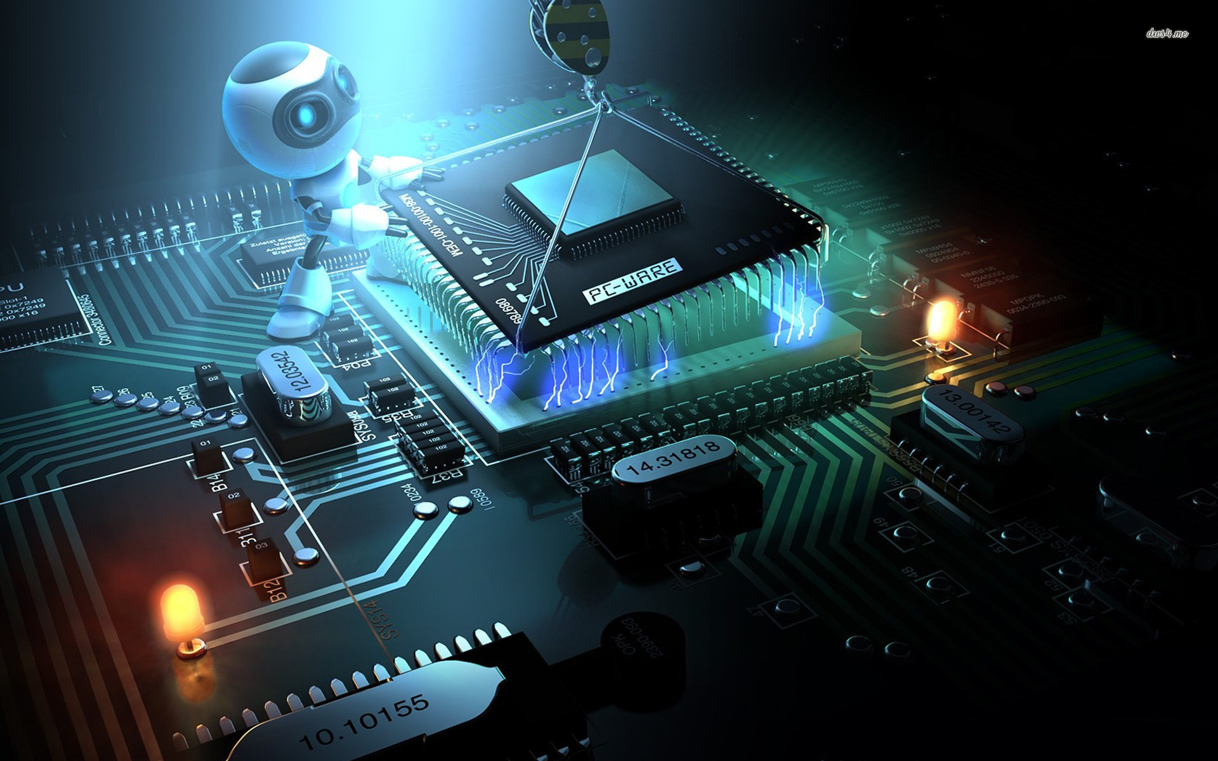
About my computer hobbie.
I like programing in C++ and play a
RPG, Simulator and Sandbox game and
i created a game called Illuminati Rage

Slide 3
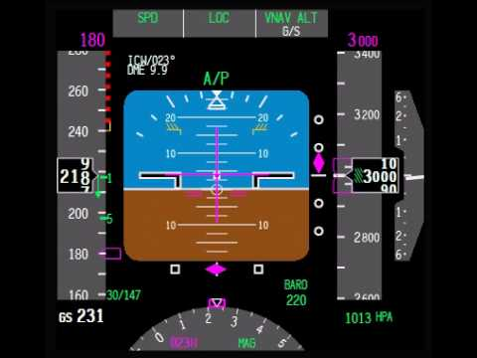
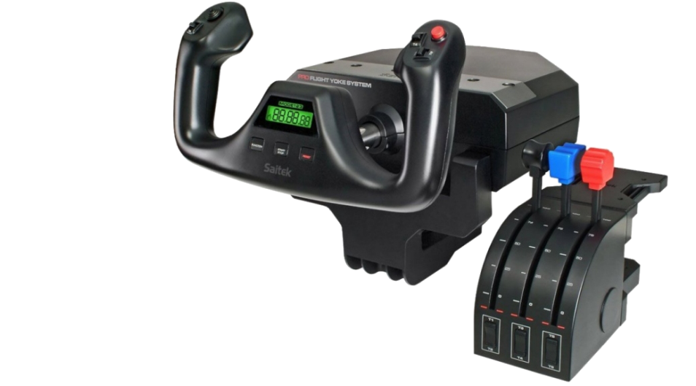
About planes and flight.
I have this yoke ☺

